Slide 1
Microsoft Power BI

Slide 2
Power BI Embedding Best Practices with the Power BI JavaScript API
Ted Pattison
Principal Program Manager
Power BI Customer Advisory Team (PBICAT)

Slide 3
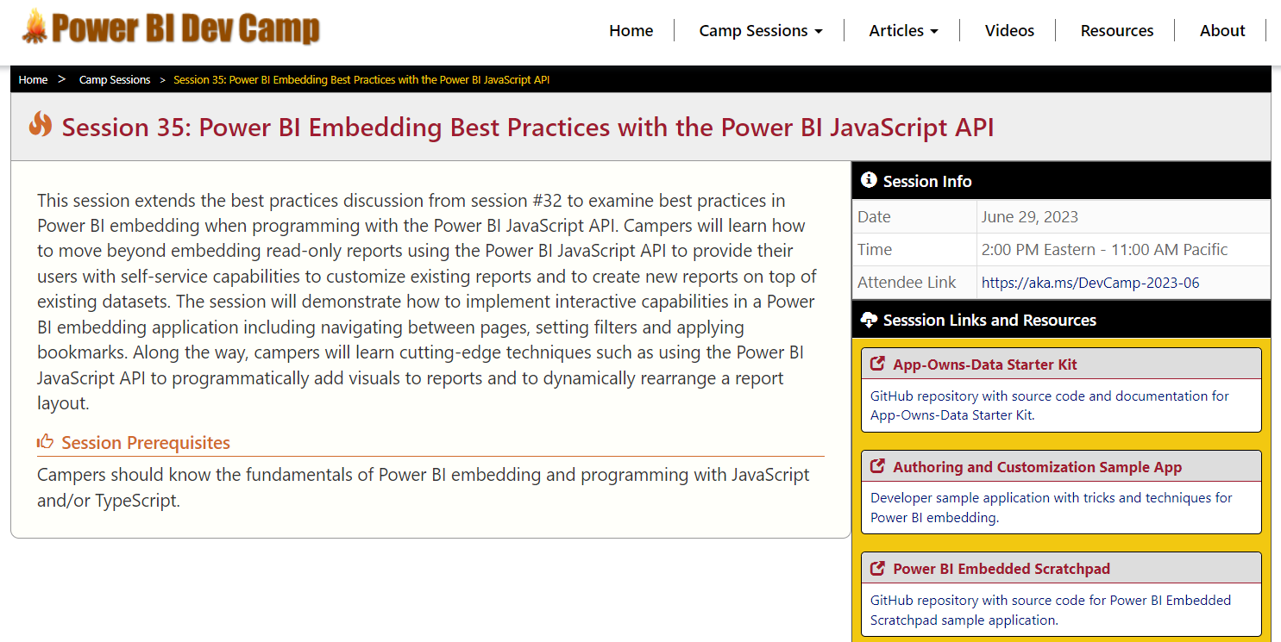
Welcome to Power BI Dev Camp
Power BI Dev Camp Portal - https://powerbidevcamp.net
There is a page for each session with links to samples, slides and other resources

Slide 4
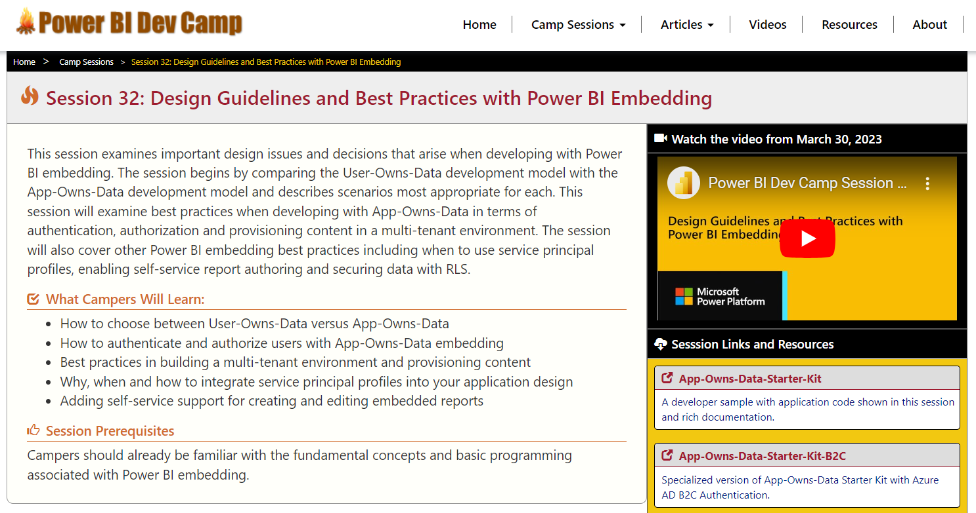
This Session Builds on Previous Session #32
Session 32: Design Guidelines and Best Practices with Power BI Embedding
https://www.youtube.com/watch?v=1y1KkqFchBc
This session continues discussion focusing on client-side code used for embedding

Slide 5
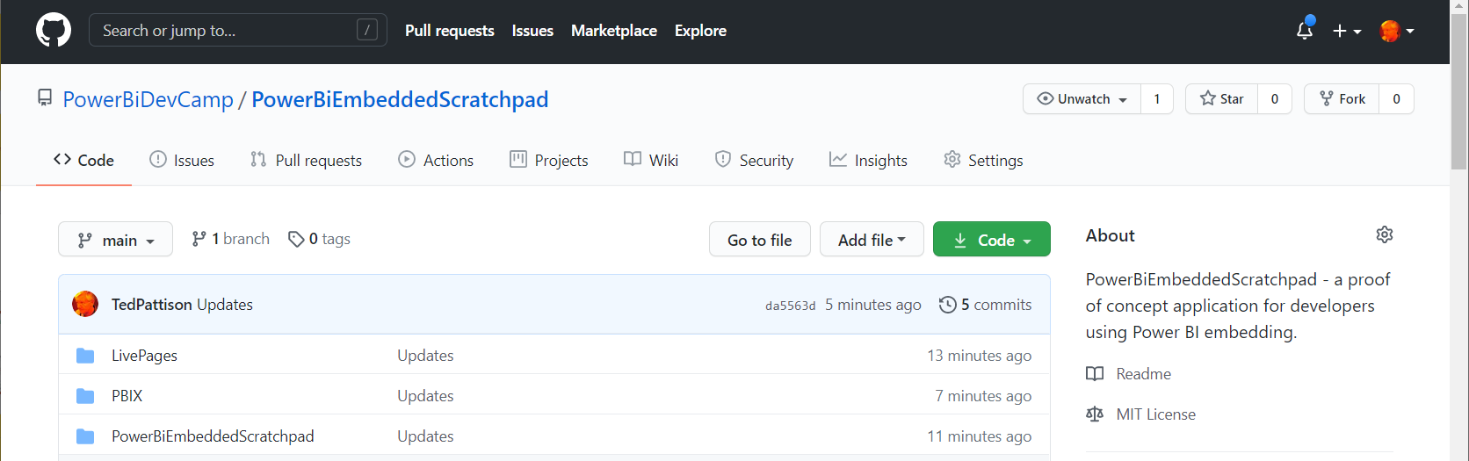
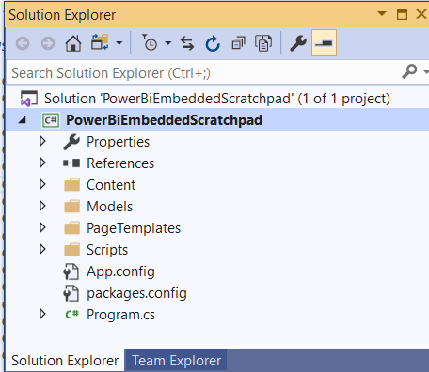
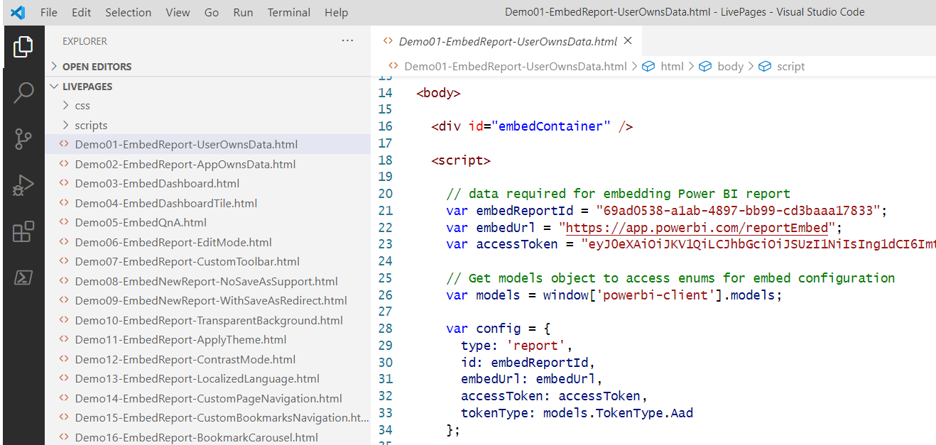
Sample #1: PowerBiEmbeddedScratchpad
https://github.com/PowerBiDevCamp/PowerBiEmbeddedScratchpad
Running App Create Test Pages

Slide 6
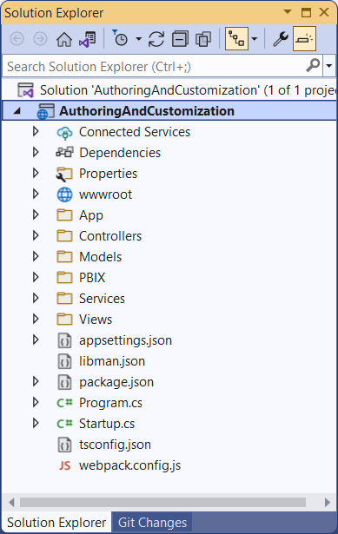
Sample #2: AuthoringAndCustomization
Developer sample demonstrates App-Owns-Data embedding techniques
Implemented as C#/.NET6 web application which uses the Power BI .NET SDK
Download from https://github.com/PowerBiDevCamp/PBIE-Authoring-And-Customization
{F5}

Slide 7
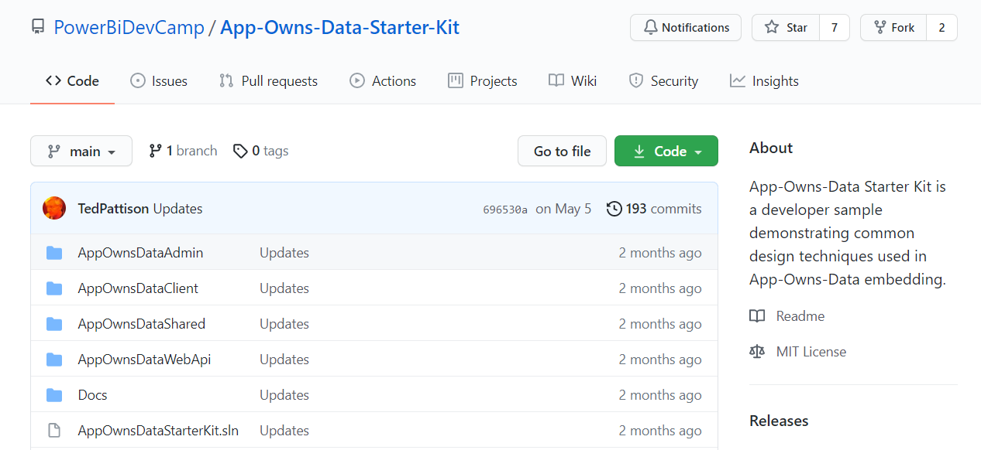
Sample #3: App-Owns-Data Starter Kit
All source code and documentation available through public GitHub repository
https://github.com/PowerBiDevCamp/App-Owns-Data-Starter-Kit
There is a second repository with a version specialized to use Azure AD B2C
https://github.com/PowerBiDevCamp/App-Owns-Data-Starter-Kit-B2C

Slide 8
Agenda
Power BI Embedding Fundamentals
Initializing an Embedded Session
Providing Interactive Behavior
Enabling Self-service Report Authoring
Leveraging Dynamic Report Binding
Extending Client-side Code using Custom Web APIs
Capturing and Monitoring Report Performance Metrics

Slide 9
Power BI Embedding – The Big Picture
User launches your app using a browser
App authenticates with Azure Active Directory and obtains access token
App uses access token to call to Power BI Service API
App retrieves data for embedded resource and passes it to browser.
Client-side code uses Power BI JavaScript API to create embedded resource
Embedded resource session created between browser and Power BI service
5
Power BI Service
Browser
iFrame
6
4
4
3
1
Your App
2
Azure AD

Slide 10
Power BI JavaScript API (powerbi.js)
Power BI JavaScript API used to embed resources in browser
Client-side JavaScript API required to develop with Power BI embedding
Documentation is titled Power BI embedded analytics Client APIs https://docs.microsoft.com/en-us/javascript/api/overview/powerbi/

Slide 11
User-Owns-Data Embedding vs App-Owns-Data Embedding
User-Owns-Data Embedding
All users require a Power BI license
Useful in corporate environments
App authenticates as current user
Your code runs with user’s permissions
User’s access token passed to browser
App-Owns-Data Embedding
No consumers require Power BI license
Useful for commercial applications
App authenticates with app-only identity
Your code runs with admin permissions
Embed token passed to browser
User-Owns-Data Embedding for use within Organization
App-Owns-Data Embedding for use by ISVs
Browser
Power BI Service
Browser
Power BI Service
iFrame
Azure AD
Access Token
for the current user
iFrame
Power BI
Embed Token
for specific report

Slide 12
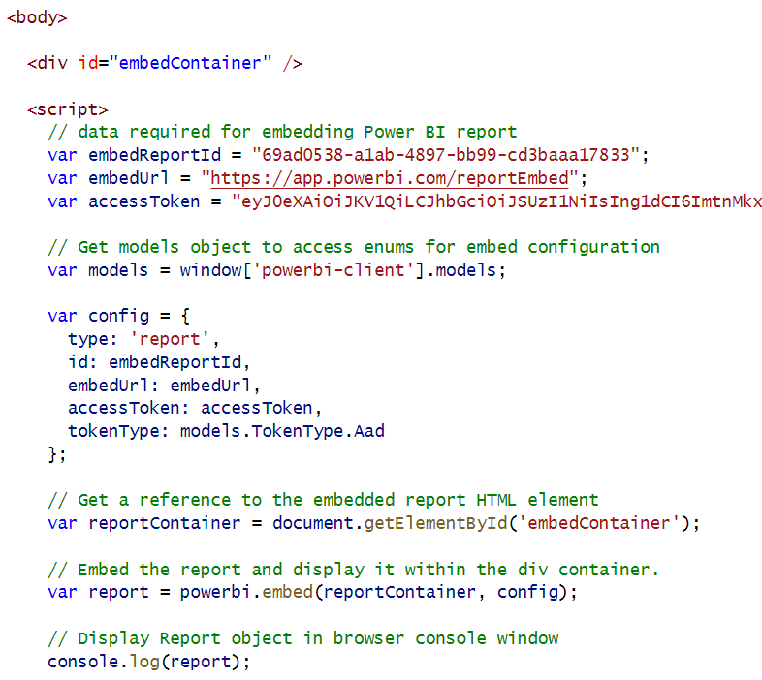
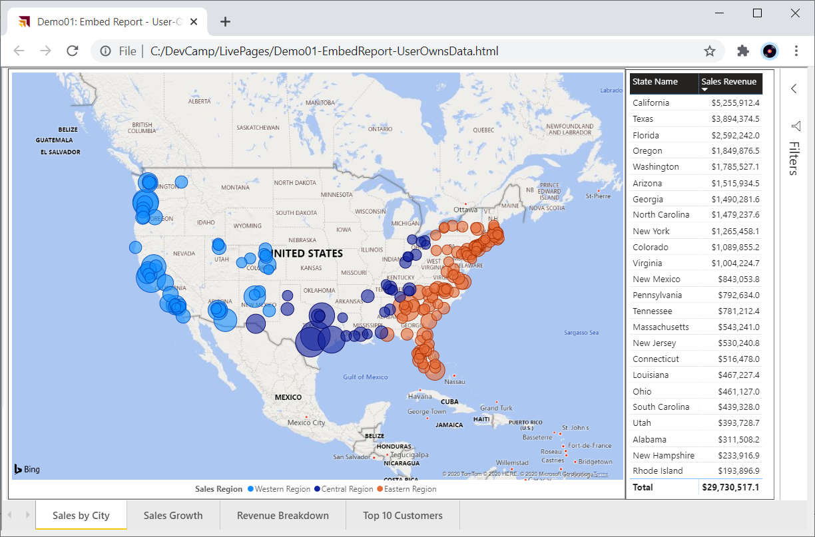
User-Owns-Data Embedding

Slide 13
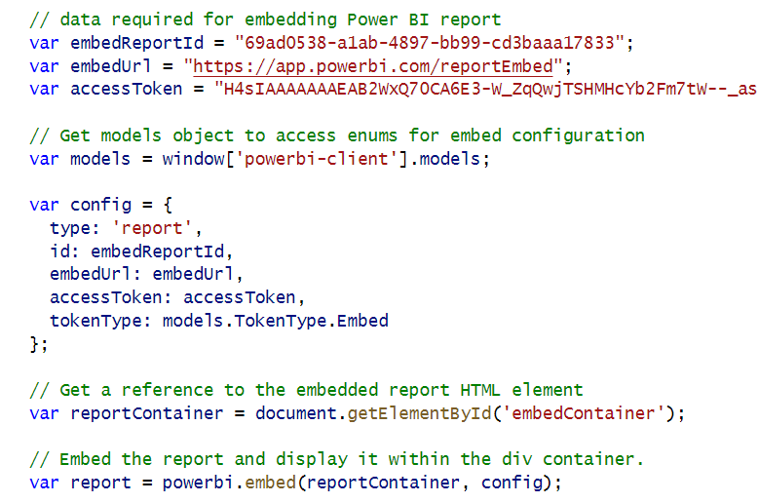
App-Owns-Data Embedding

Slide 14
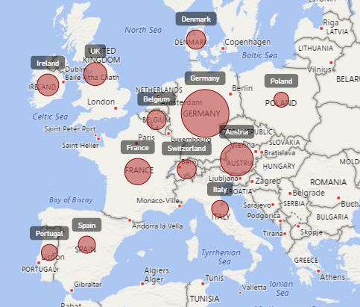
Report Embedding Architecture
Embedding involves creating an iFrame on the page
PBIJS transparently creates iFrame and sets source to Power BI Service
The iFrame and hosting page originate from different DNS domains
https://app1.mydomain.com
Your HTML and CSS
Web Hosting Server
Your
JavaScript
iFrame
Embedding Data
https://wabi-us-east2-redirect.analysis.windows.net/
powerbi.js
Power BI Service

Slide 15
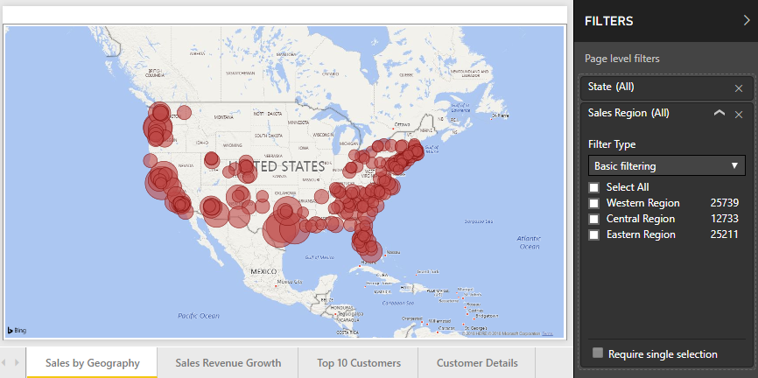
A Promise-based Programming Model
Design of PBIJS simulates HTTP protocol
Creates more intuitive programming model for developers
Programming based on asynchronous requests and promises
Embedded objects programmed using actions and events
Actions
report.fullscreen
report
report.switchMode
report.setFilters
Your
JavaScript
report.getPages
Events
report.loaded
report.pageChanged
report.commandTriggered

Slide 16
Exploring powerbi.js Events
Demo01
Demo01 registers event handlers for all supported powerbi.js events
Use it to gain understanding of which user actions trigger specific events
Event arguments logged to console window for easy inspection

Slide 17
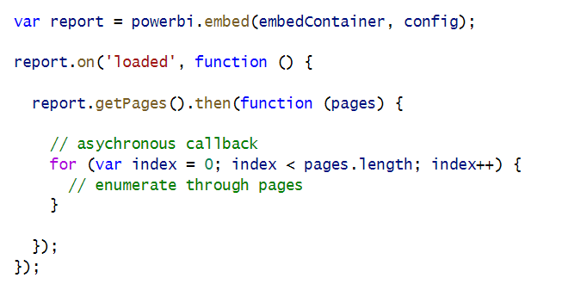
Calling report.getPages() in the loaded event

Slide 18
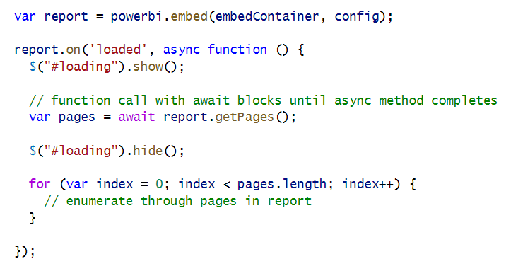
Using async and await keywords in JavaScript

Slide 19
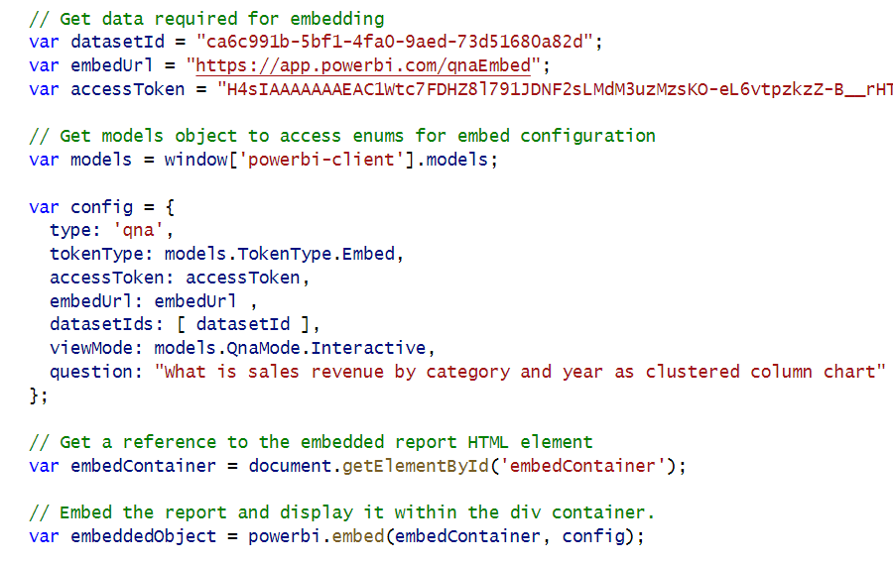
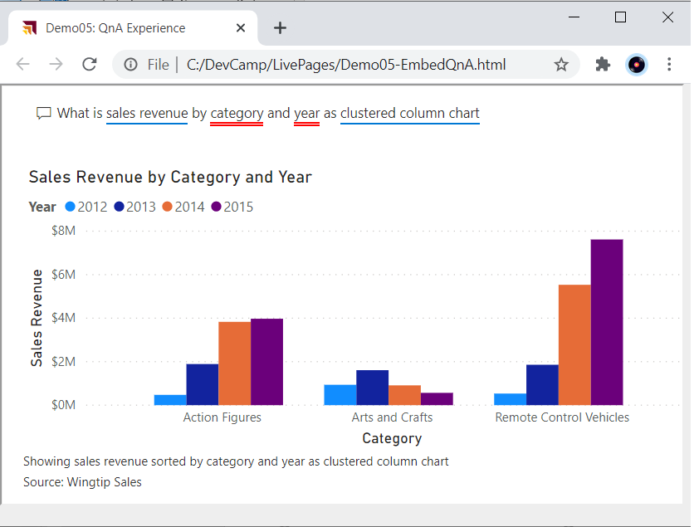
Embedding Other Artifact Types

Slide 20
Agenda
Power BI Embedding Fundamentals
Initializing an Embedded Session
Providing Interactive Behavior
Enabling Self-service Report Authoring
Leveraging Dynamic Report Binding
Extending Client-side Code using Custom Web APIs
Capturing and Monitoring Report Performance Metrics

Slide 21
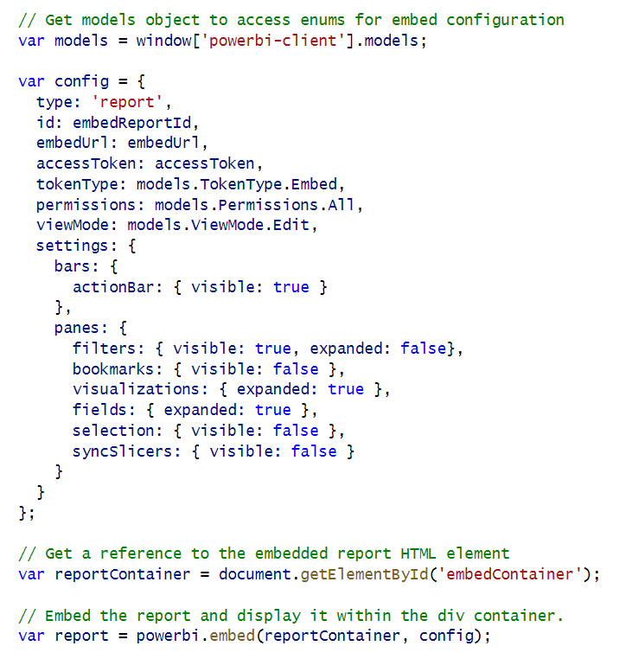
Initializing Panes When Embedding a Report
Demo02
Report panes and action bar can be set in config object
Filter pane and Bookmarks pane are only panes available in View mode
Other panes are only available when report is in Edit mode

Slide 22
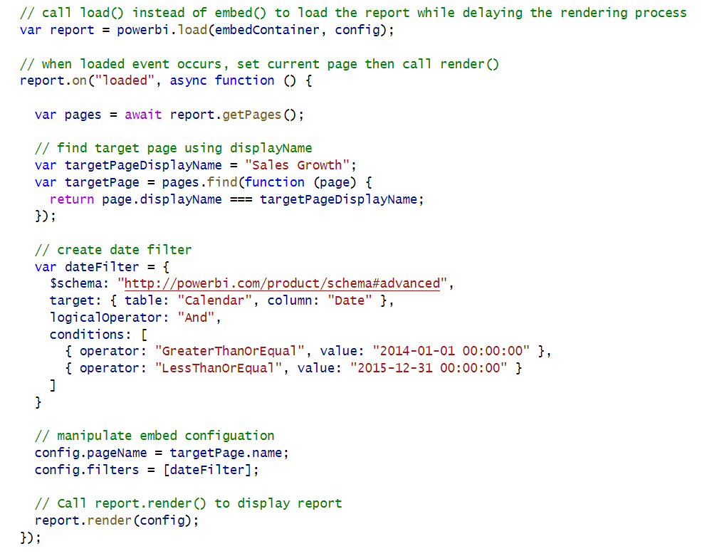
Phased Embedding

Slide 23
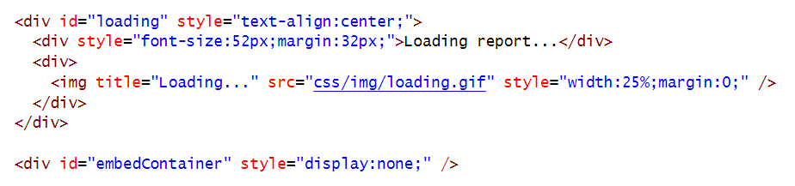
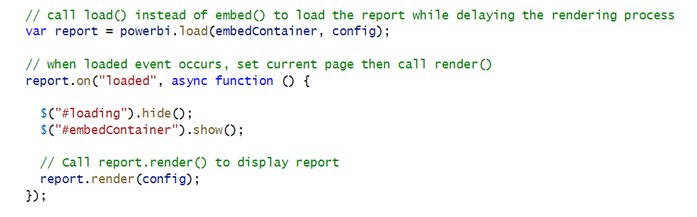
White Label Report Loading

Slide 24
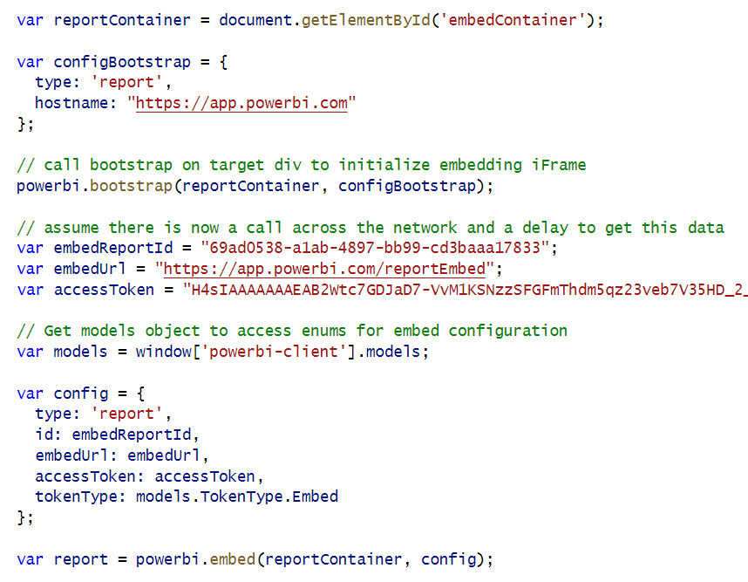
Bootstrap Optimization in Report Loading

Slide 25
Best Practice – Use Report Themes for Styling & Branding

Slide 26
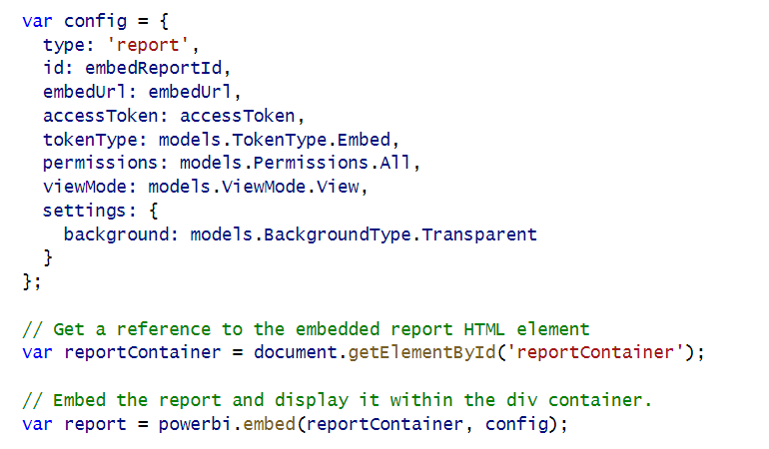
Embed Report with Transparent Background

Slide 27
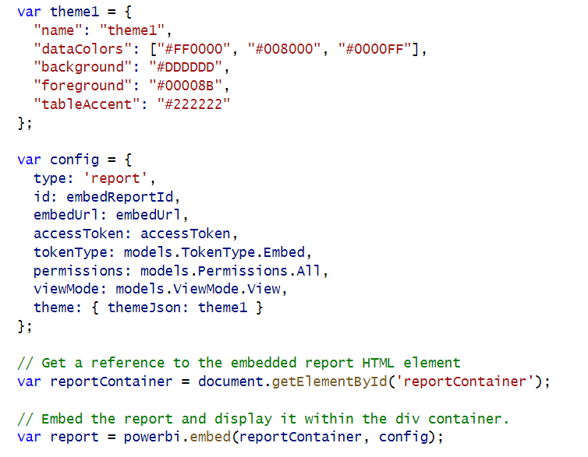
Applying Report Themes

Slide 28
Best Practice – Improve Accessibility using Contrast Mode

Slide 29
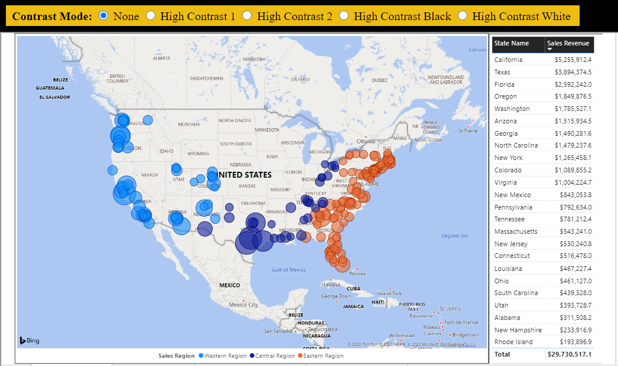
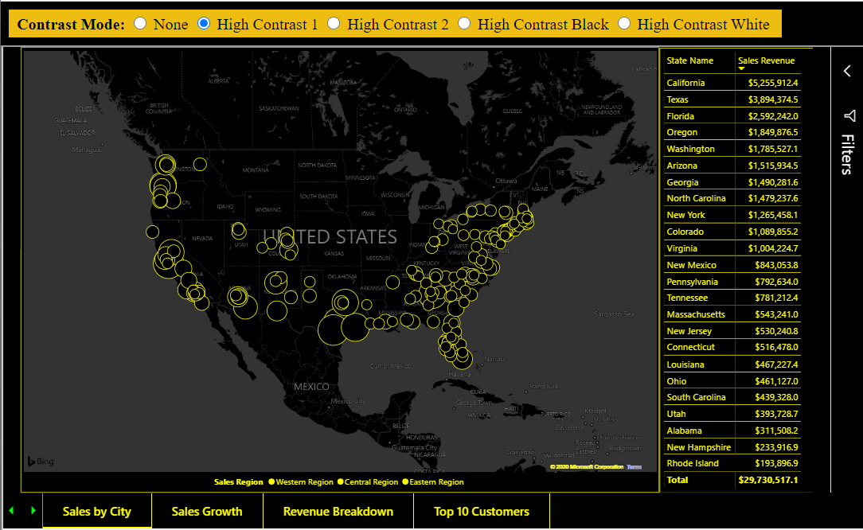
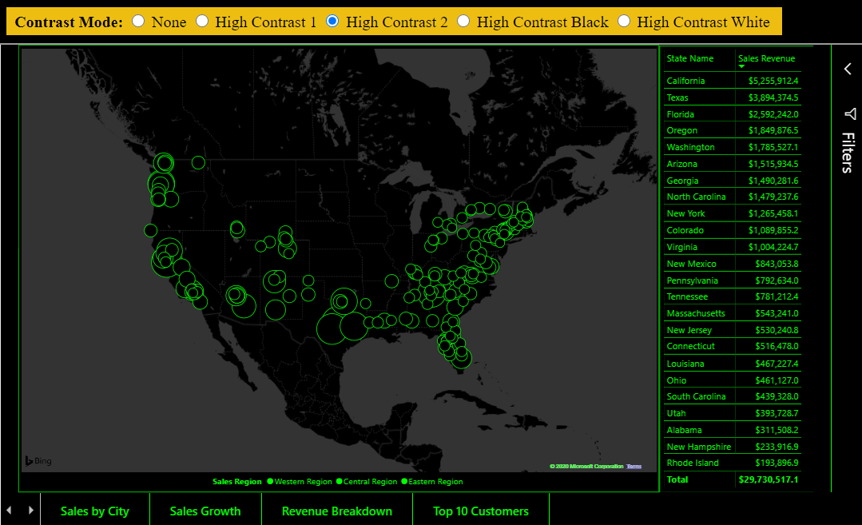
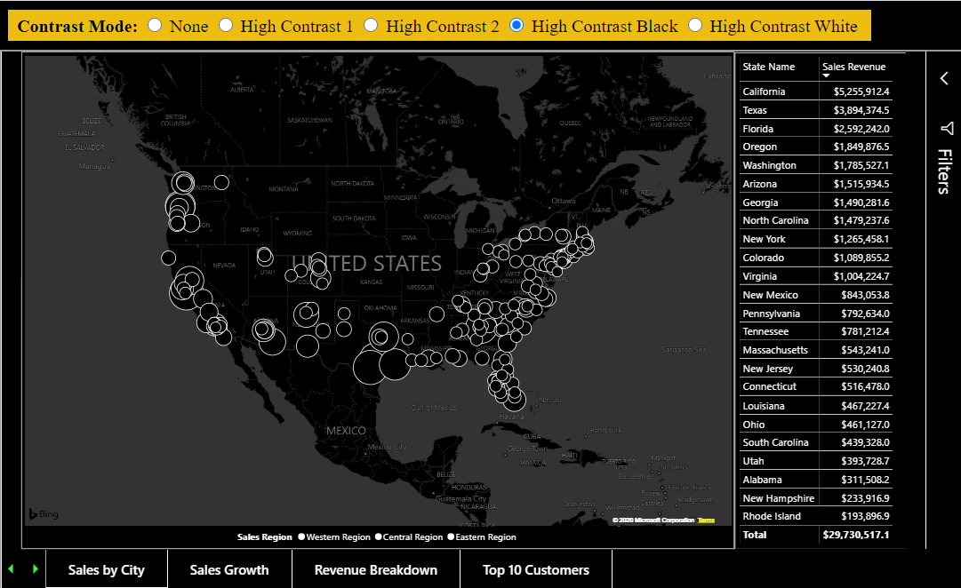
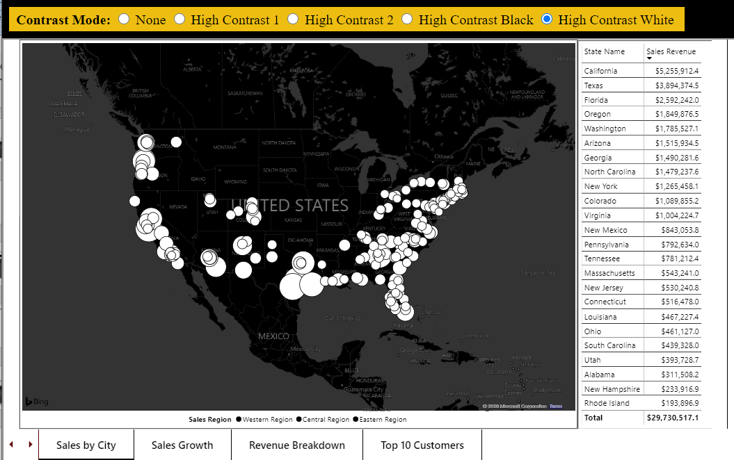
Contrast Mode

Slide 30
Best Practice – Use Only One iFrame per Web Page
Each embedded report on a host web page has overhead
Load phase
Render phase
"Embed a Visual" is actually embedding host report behind the scenes
embedding multiple visuals == embedding multiple reports
Use Custom Layout with single report page
Requires extra code to hide, show and position visuals
Provides flexible UI layout while running inside single iFrame

Slide 31
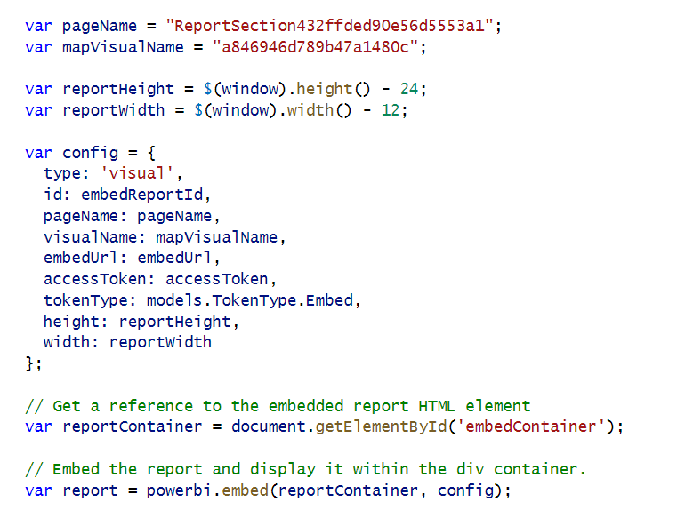
Embedding a Single Visual
Limit this to one visual embed per page – it really embeds the whole report then shows one visual

Slide 32
Getting the Names of Pages and Visuals
Demo06
You can discover page names and visual names using Demo01 events explorer
In some scenarios, you might want to hard-code page and visual names into your code

Slide 33
Creating a Static Custom Layout
Demo06
You can set x position, y position, width and height for each visual in a custom layout

Slide 34
Creating a Custom Layout without Hard-coded IDs
Demo06

Slide 35
Displaying a Single Visual
Demo06
Create a custom layout that only display a single visual
Visual can be sized to full width and height of report
Use defaultLayout to hide all other visuals by default.

Slide 36
Agenda
Power BI Embedding Fundamentals
Initializing an Embedded Session
Providing Interactive Behavior
Enabling Self-service Report Authoring
Leveraging Dynamic Report Binding
Extending Client-side Code using Custom Web APIs
Capturing and Monitoring Report Performance Metrics

Slide 37
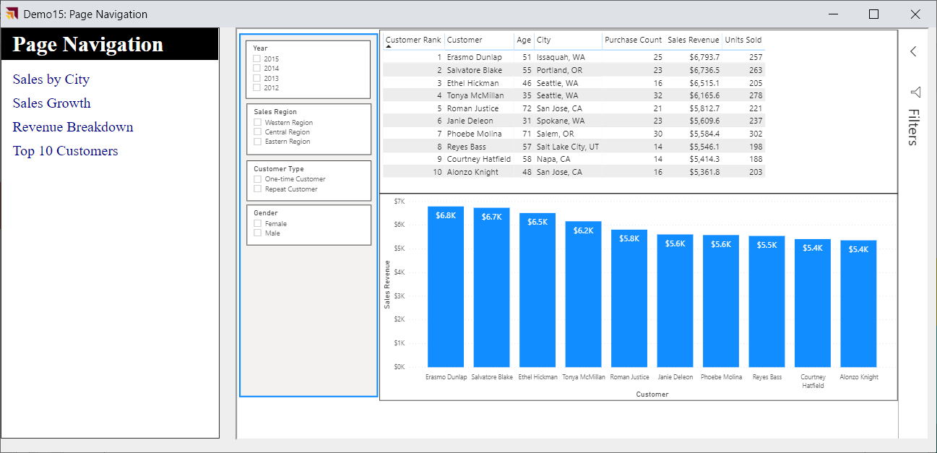
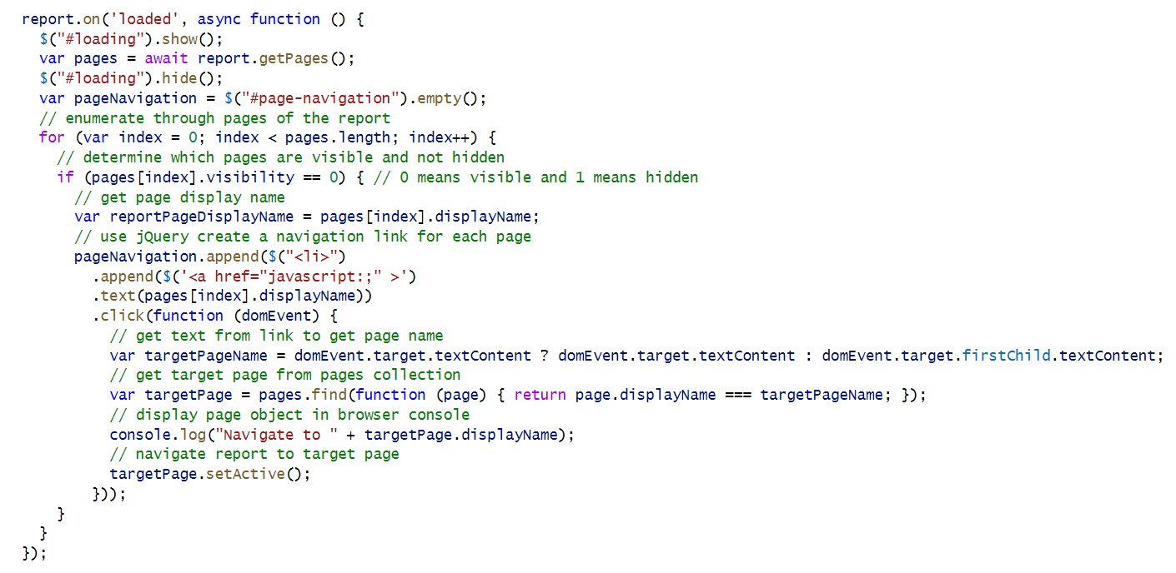
Custom Page Navigation

Slide 38
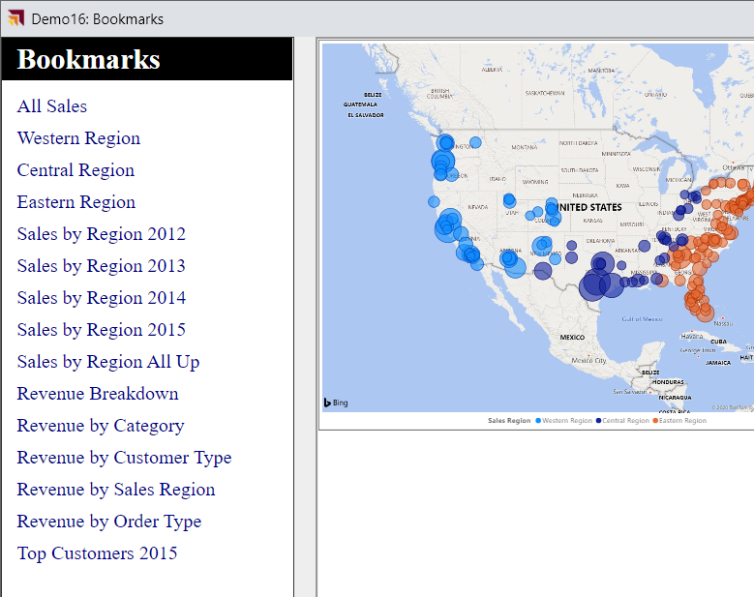
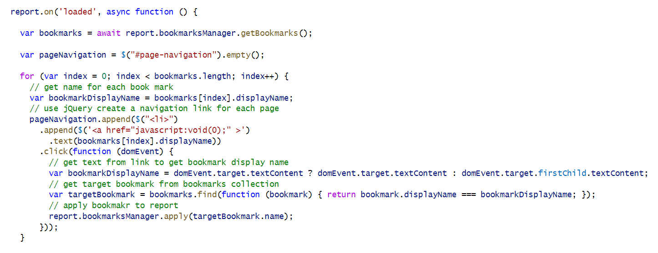
Custom Bookmark Navigation

Slide 39
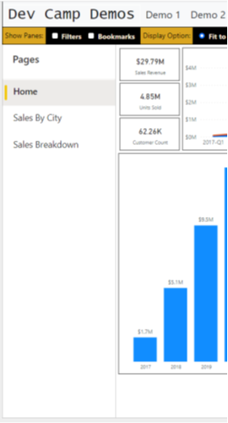
Report Navigation Settings
Demo02
You can show or hide page-based navigation menu used in Power BI Service
Page navigation can be shown on left side of page or bottom of page
set navigation
left navigation
bottom navigation

Slide 40
Creating a Custom Navigation Scheme
Demo02
Custom Navigation can be added using pages or bookmarks

Slide 41
Adding Custom Navigation using Report Bookmarks
Demo07
Let's start by adding navigation using bookmarks defined inside the report

Slide 42
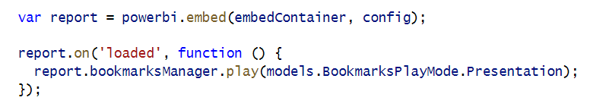
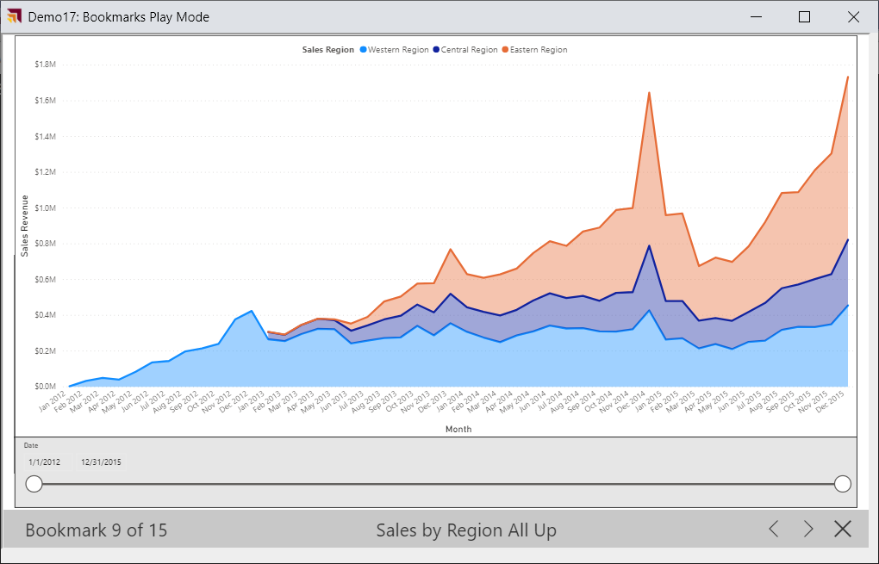
Bookmark Play Mode

Slide 43
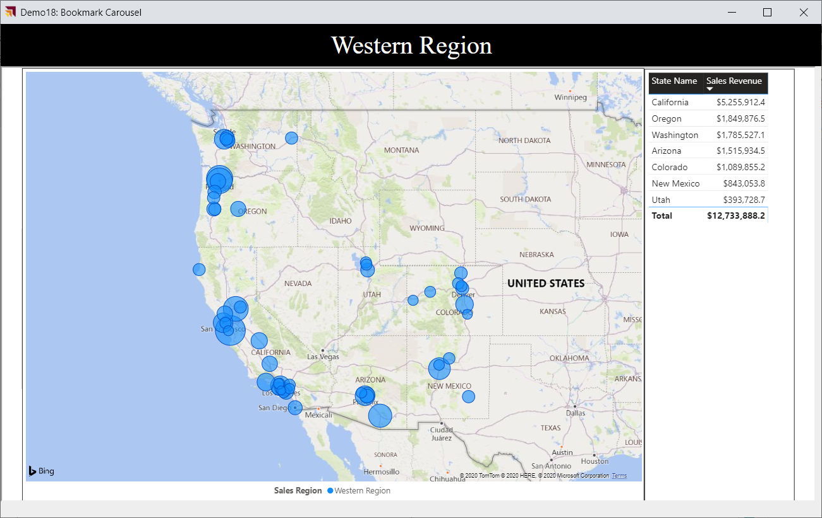
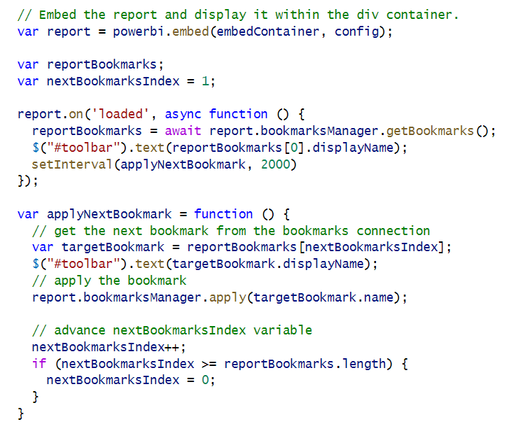
Bookmark Carousel

Slide 44
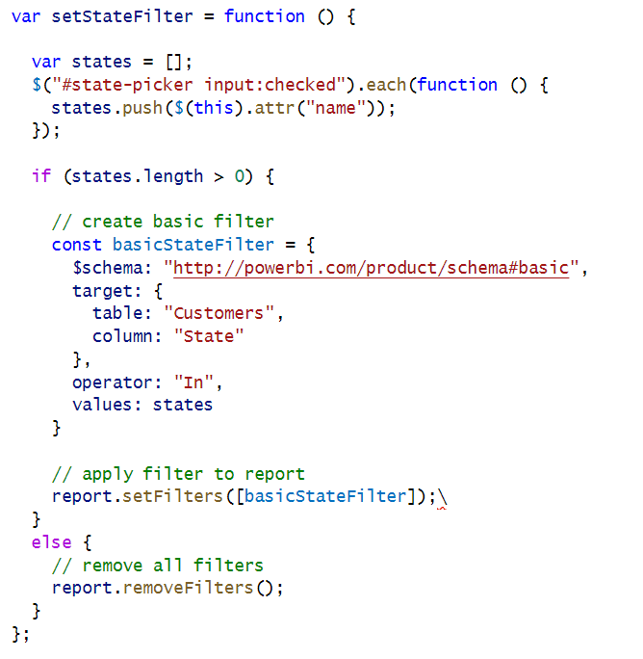
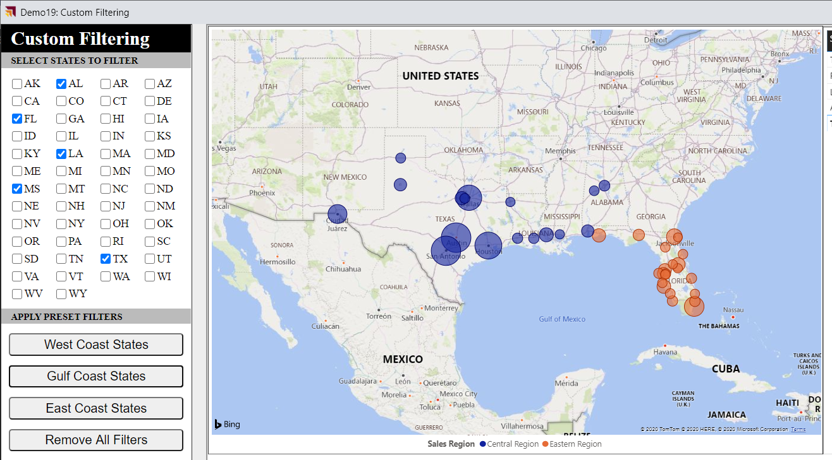
Implementing a Custom Filtering Experience

Slide 45
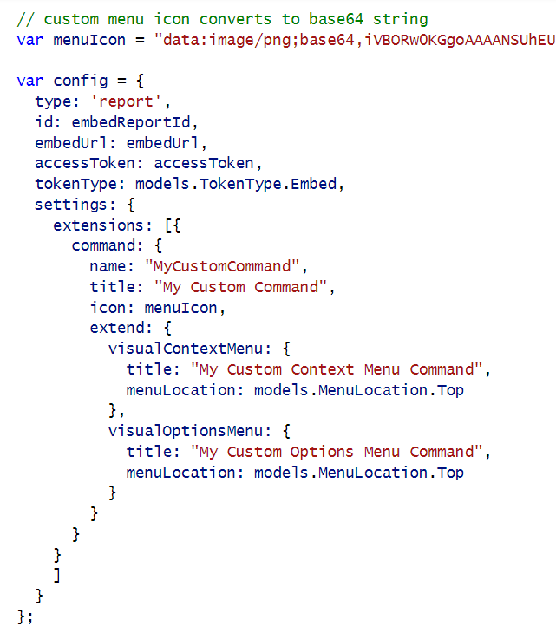
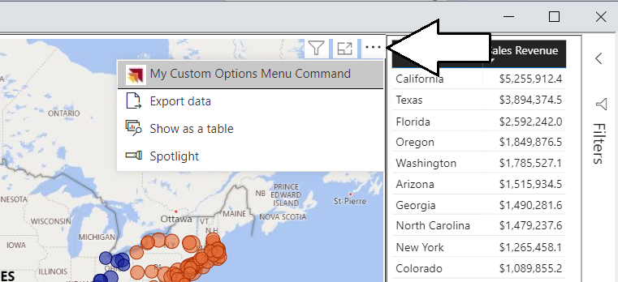
Adding Visual Menu Commands

Slide 46
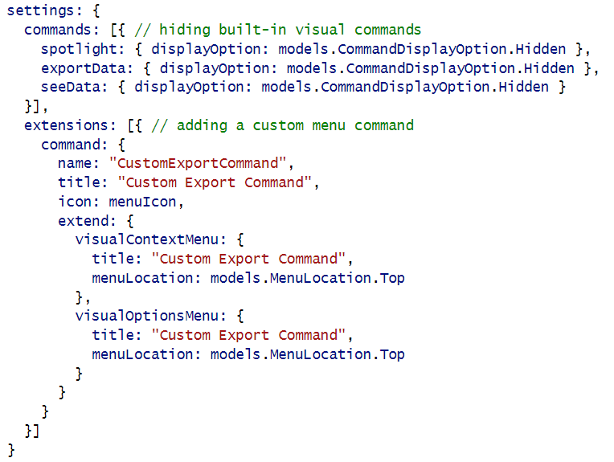
Hiding Built-in Visual Menu Commands

Slide 47
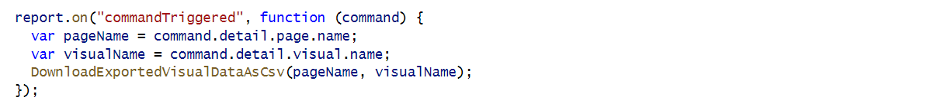
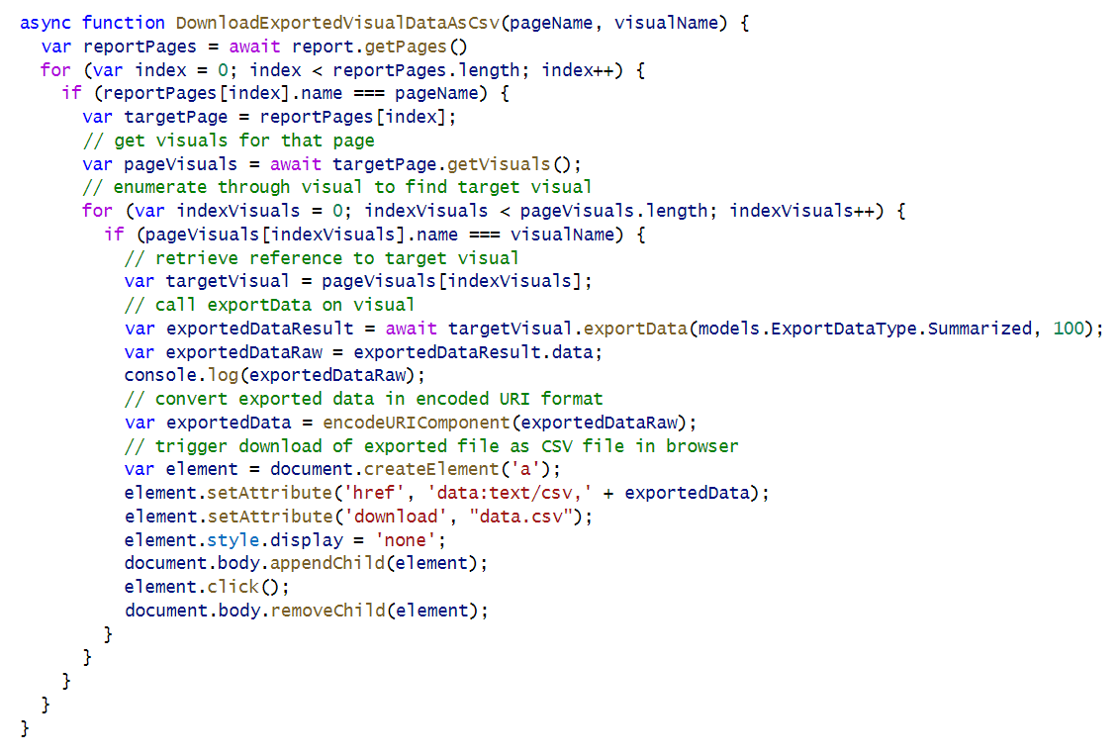
Create a Custom Visual Export Command

Slide 48
Agenda
Power BI Embedding Fundamentals
Initializing an Embedded Session
Providing Interactive Behavior
Enabling Self-service Report Authoring
Leveraging Dynamic Report Binding
Extending Client-side Code using Custom Web APIs
Capturing and Monitoring Report Performance Metrics

Slide 49
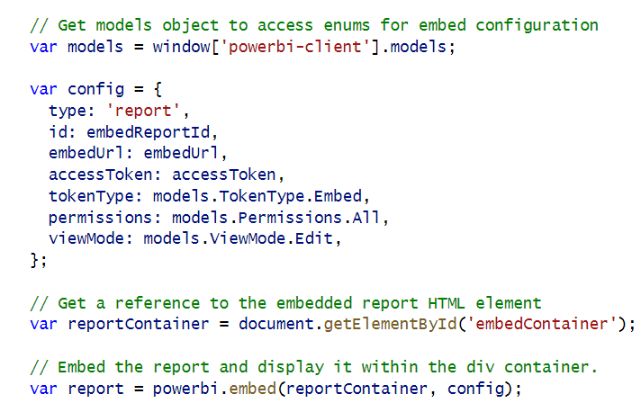
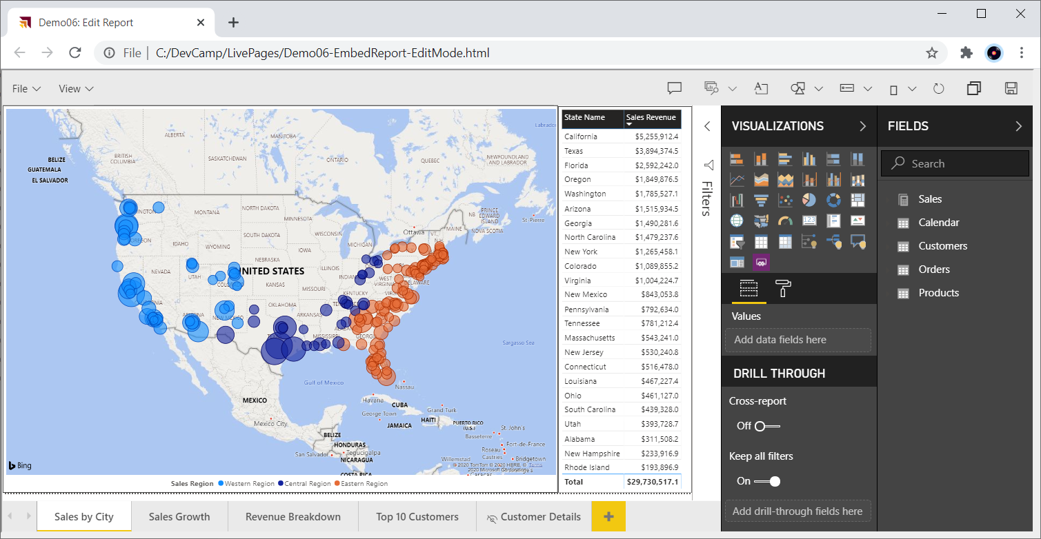
Embedding Reports in Edit Mode

Slide 50
Report Panes

Slide 51
Moving a Report into Edit Mode
Demo03
Report can be opened in Edit mode or switched into Edit mode after opening
Minimal code required to switch report into Edit mode
For user to perform Save operation, embed token must have reportId with allowEdit set to true
For user to perform Save As operation, embed token must include workspaceId

Slide 52
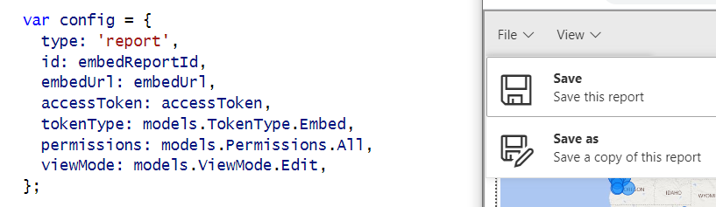
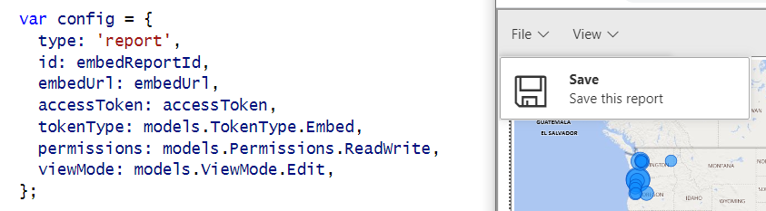
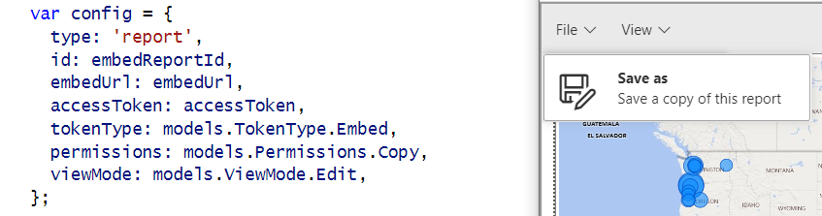
Showing and Hiding the Save and Save as Menus
Demo03
permissions: models.Permissions.All
permissions: models.Permissions.ReadWrite
permissions: models.Permissions.Copy

Slide 53
Implementing the Save-As Redirect
Demo03
saved event fires on both Save and SaveAs actions.
Call to EmbedTokenController Web API to get new embed token with the report ID of the new report

Slide 54
GetEmbedToken
Demo03
Create token request object collections
add IDs for workspaces
add all dataset IDs from source workspace
add all report IDs from source workspace
add all report IDs from target workspace
Create GenerateTokenRequestV2 object
Call Power BI REST API to generate token
Return token to caller as a string

Slide 55
Using a Custom SaveAs Dialog
Demo04
Power BI embedding supports using custom Save As dialog
saveAsTriggered event fires when user in selects Save As command from action bar
Your code must display custom dialog and then execute report.SaveAs

Slide 56
Saving Copy of Report to a Target Workspace
Demo04
When calling report.SaveAs, you can specify a target workspace
Customized reports can be saved and maintained in different workspaces
Embed token requires workspace ID for target workspace

Slide 57


Embed a New Report

Slide 58

New Report with Save As Redirect

Slide 59
Agenda
Power BI Embedding Fundamentals
Initializing an Embedded Session
Providing Interactive Behavior
Enabling Self-service Report Authoring
Leveraging Dynamic Report Binding
Extending Client-side Code using Custom Web APIs
Capturing and Monitoring Report Performance Metrics

Slide 60
Best Practice – Use Dynamic Report Binding
Guidelines
Create dataset with common schema for each customer in isolated customer workspace
Maintain one set of reports in shared workspace
Use dynamic binding to connect shared report to client-specific dataset
ADD DIAGRAM
shared report
workspace – customer 1
dataset 1
dataset 2
workspace – customer 2
dataset 2
shared workspace
workspace – customer 3
shared report
dataset 3
empty dataset

Slide 61


Dynamic Dataset Binding

Slide 62
Agenda
Power BI Embedding Fundamentals
Initializing an Embedded Session
Providing Interactive Behavior
Enabling Self-service Report Authoring
Leveraging Dynamic Report Binding
Extending Client-side Code using Custom Web APIs
Capturing and Monitoring Report Performance Metrics

Slide 63

Best Practice – Extend Client-side Code using Web APIs
Each AuthoringAndCustomization demo page runs as a Single Page Application (SPA)
HomeController returns HTML for each page along with JavaScript viewModel with embedding data
Some demo pages require Web API callbacks after initial page has loaded
Demo08 includes Web API callbacks that read and write to underlying SQL database
CAVEAT: This is a proof-of-concept (POC) application with no user authentication or authorization
HomeController
EmbedTokenController
Bookmarks Controller
AppOwnsDataCustomizationDB

Slide 64
Best Practice – Provide Users with Export Operations
Requires extra effort when developing with App-Owns-Data embedding

Slide 65
Best Practice – Leverage Custom Bookmarks
Best Practice – Personalize User Experience with Custom Bookmarks to

Slide 66
Capturing a Custom Bookmark
Demo07

Slide 67
Demo08 demonstrates persisting bookmarks in database
Application design support Shared Bookmarks and Personal Bookmarks
Shared bookmark seen by all report consumers
Personal bookmark only seen by user that created it
Bookmarks Controller
SharedBookmarks
table
PersonalBookmarks
table

Slide 68
Tables for Persisting Custom Bookmarks
SharedBookmarks table
PersonalBookmarks table

Slide 69
Loading with Persisted Bookmarks
Demo08

Slide 70
Adding Personalized Report Subscriptions
Demo08
With App-Owns-Data embedding, Power BI does not know user identity
App-Owns-Data embedding does not provide SaaS-style personalization features
Personalization features must be fully implemented by developer
Let's explore application design to support personalized report subscriptions
Start by allow users to save subscription information to ReportSubscriptions table
Implement subscriptions service to read to ReportSubscriptions table and export reports
PDF files for exported reports can be sent to users via email attachment

Slide 71
Agenda
Power BI Embedding Fundamentals
Initializing an Embedded Session
Providing Interactive Behavior
Enabling Self-service Report Authoring
Leveraging Dynamic Report Binding
Extending Client-side Code using Custom Web APIs
Capturing and Monitoring Report Performance Metrics

Slide 72
Power BI Embedding and Report Loading Performance
Some developers complain that Power BI embedding introduces performance issues
Test the report in the Power BI Service and in the Power BI Embedding Developer Playgound

Slide 73
Summary
Power BI Embedding Fundamentals
Initializing an Embedded Session
Providing Interactive Behavior
Enabling Self-service Report Authoring
Leveraging Dynamic Report Binding
Extending Client-side Code using Custom Web APIs
Capturing and Monitoring Report Performance Metrics

